Slide 1
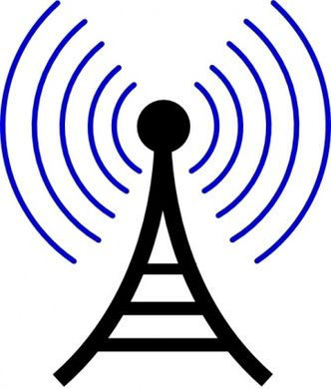
Making waves The role of radio in communicating social change
Dr Evangelia Papoutsaki
Communication and Media Program
evangelia.papoutsaki@uncentralasia.org
Notes:
Greetings, in this presentation I would like to share with you some of my experience in mapping community based radio in the Pacific. I will give an overview of what community based radio is and some of its key characteristics, some examples of the impact community radio can have on sustaining and positively developing communities that are often marginalized or remote from the center and then focus on two case studies from Japan’s Amami islands to demonstrate that community based radio can play is vital role in strengthening small and remote island communities that share similar characteristics to Central Asia’s remote and mountainous communities.
I would like here to make a distinction between radio, community radio and community based radio. in this presentation, I will be referring to community based radios as an inclusive term that brings together any radio that serves a community.

Slide 2
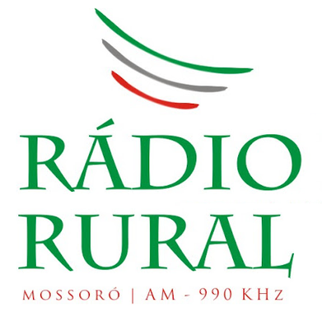
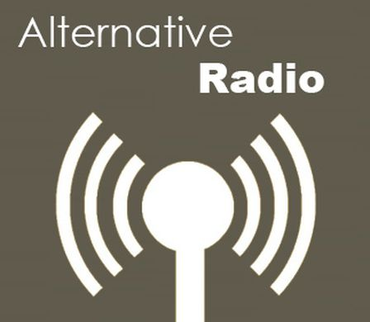
Serving community
Rural
Urban
Neighborhood
Special community focused
Limited signal
Short-waves
Digital
Community radio
Rural radio
Co-operative radio
Participatory radio
Free radio
Alternative radio
Popular radio
Educational radio
Grassroots radio
http://www.amarc.org/?q=node/47

Slide 3
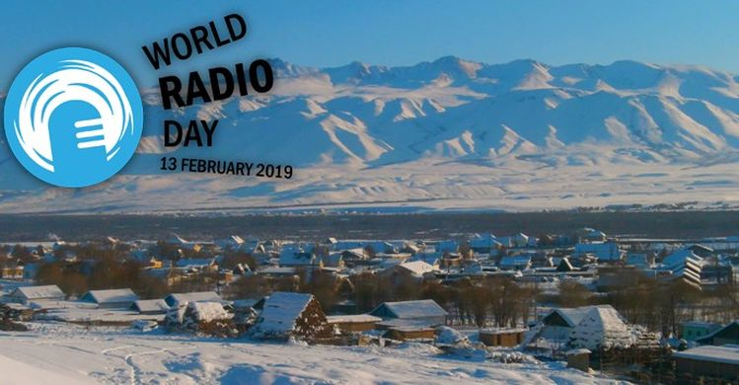
Why community based radios?
Notes:
We are very close to celebrating world radio day, so the obvious question is why community based radios? The answer I believe is well illustrated in this quote by nuestros medios/our media international community media network that takes a community needs and rights approach :

Slide 4
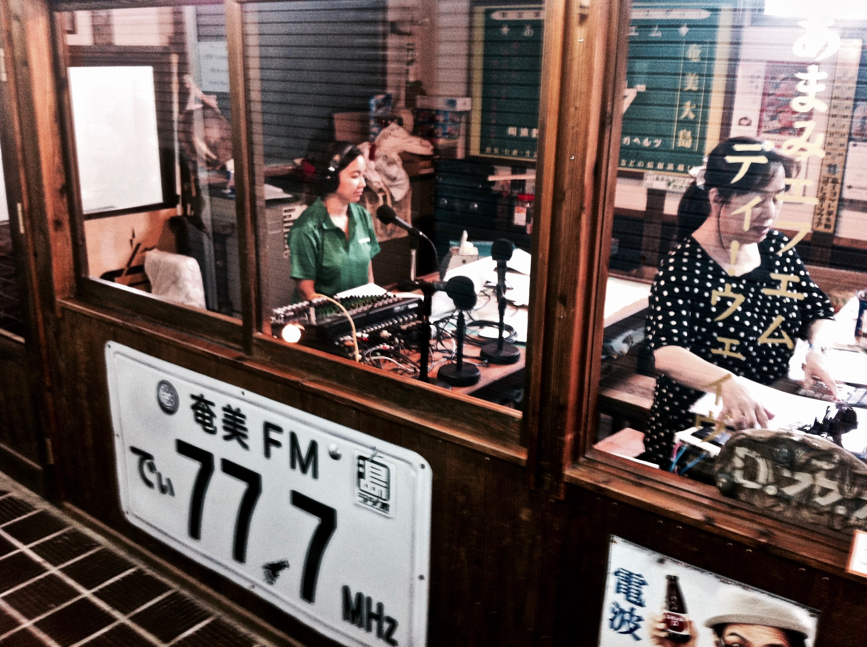
“All communities & collectives need to communicate, to express themselves, to inform & be informed, to dialogue with others, & to network. To have these communication needs met is the right of every community & collective” (Nuestros Medios)
A Community Needs &Rights Based Approach
Notes:
So, how can this approach help us better understand what tole can community based radio play in supporting remote communities in Centrl asia?

Slide 5
“Because communication is a basic right and a necessary condition for social and economic development, community media can make a strategic contribution to that development”
“Community […] media are important means of providing access to public information, fostering public involvement & promoting societal development & social cohesion” (AMARC)

Slide 6
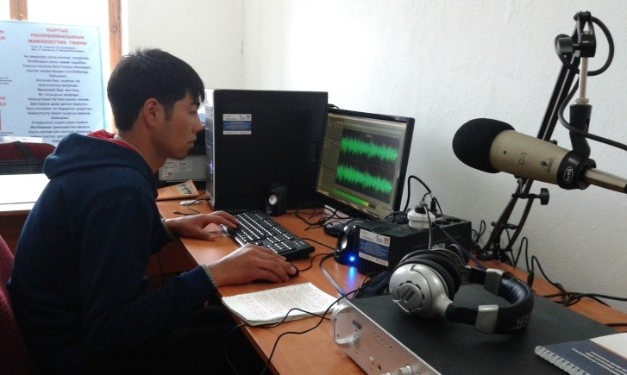
What is community radio?
A third model in addition to commercial & public/government broadcasting..
Generally non for profit.
Serves geographic communities & communities of interest.
Broadcasts content that is relevant to a local, specific audience.
Operated, owned & influenced by the community it serves.
A mechanism for enabling individuals, groups, & communities to tell their own stories, to share experiences and, in a media-rich world, to become creators & contributors of media.
https://youtu.be/BqHF4b37pD8

Slide 7
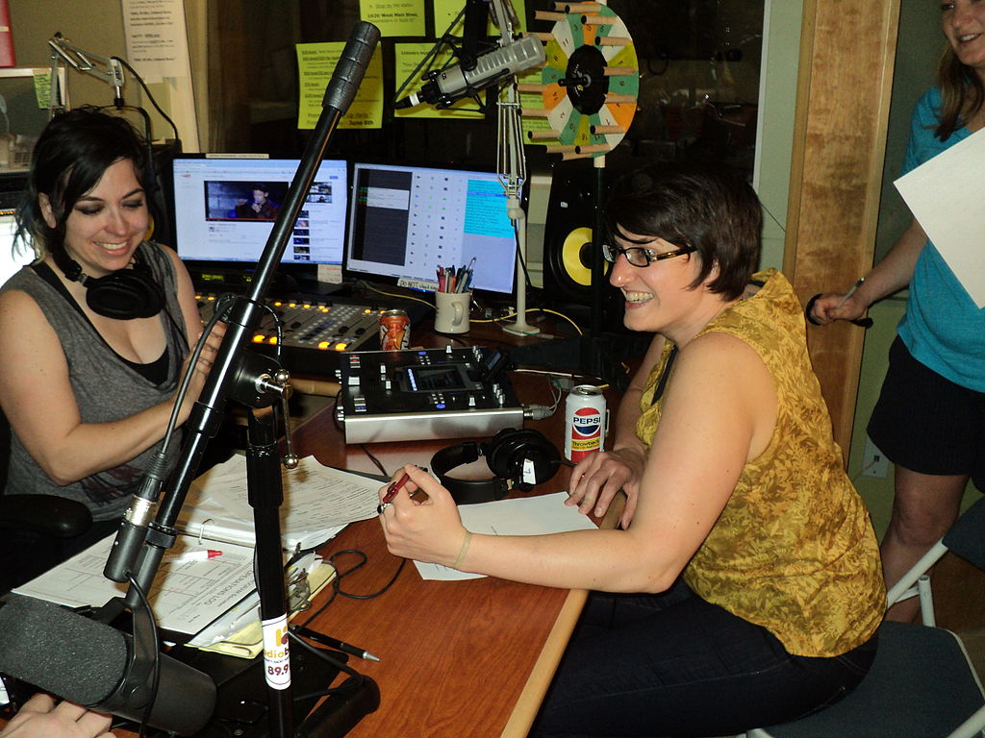
Community based radio is characterized by:
….its ownership & programming & the community it is authorized to serve.
… owned & controlled by a NPO whose structure provides for membership, management, operation & programming primarily by members of the community at large.
…its programming that should be based on community access & participation & should reflect the special interests & needs of the listenership it is licensed to serve.
Independent Radio and Television Commission of Ireland

Slide 8
Much of the legislation on community radio has included phrases such as "social benefit”, "social objectives" & "social gain"
as part of the definition.
Notes:
These phrases signal the connection of community radio to social change

Slide 9
Vital medium for development & social change
RADIO was THE FIRST personal mass communications system & remains a highly personalized, imagination-stimulating medium well suited for reaching out & establishing an individual bond between announcer & unseen listener.
By virtue of the internet, a small-town station can be heard anywhere in the world; by virtue of the podcast, radio can be carried by anyone anywhere they travel.
Even in the age of digital media, community-based radio remains a vital medium for social change.
Notes:
Radio’s potential impact on social change
Health
Education
Civics
Gender equality
Culture-identity
Conflict resolution and peace building
Climate change

Slide 10
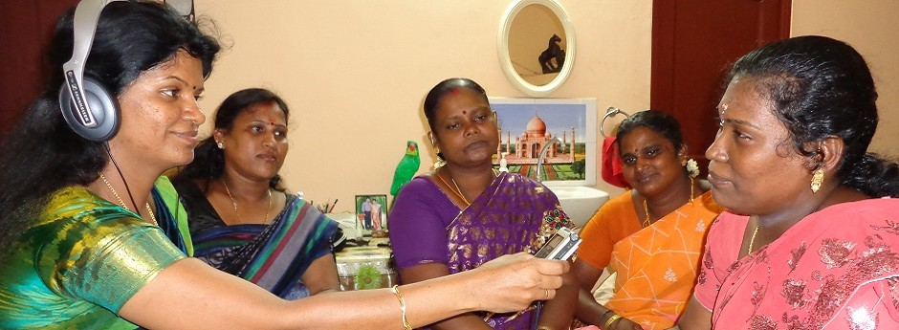
Community radio efforts publicize immunization days in Uganda, women’s rights in Mozambique, equality for ethnic & religious minority groups in Tbilisi, the plight of homeless children in Kosovo, anti-gang efforts in Rio de Janeiro, literacy for youth in the Philippines, the struggle for clean water in Western Orissa, India. http://www.creativitypost.com/arts/radio_rising_social_change_at_the_speed_of_sound2
Notes:
With such high TB infection rates in Kg, community radio can be used more effectively in breaking down stigmatization and raising awareness for treatment

Slide 11
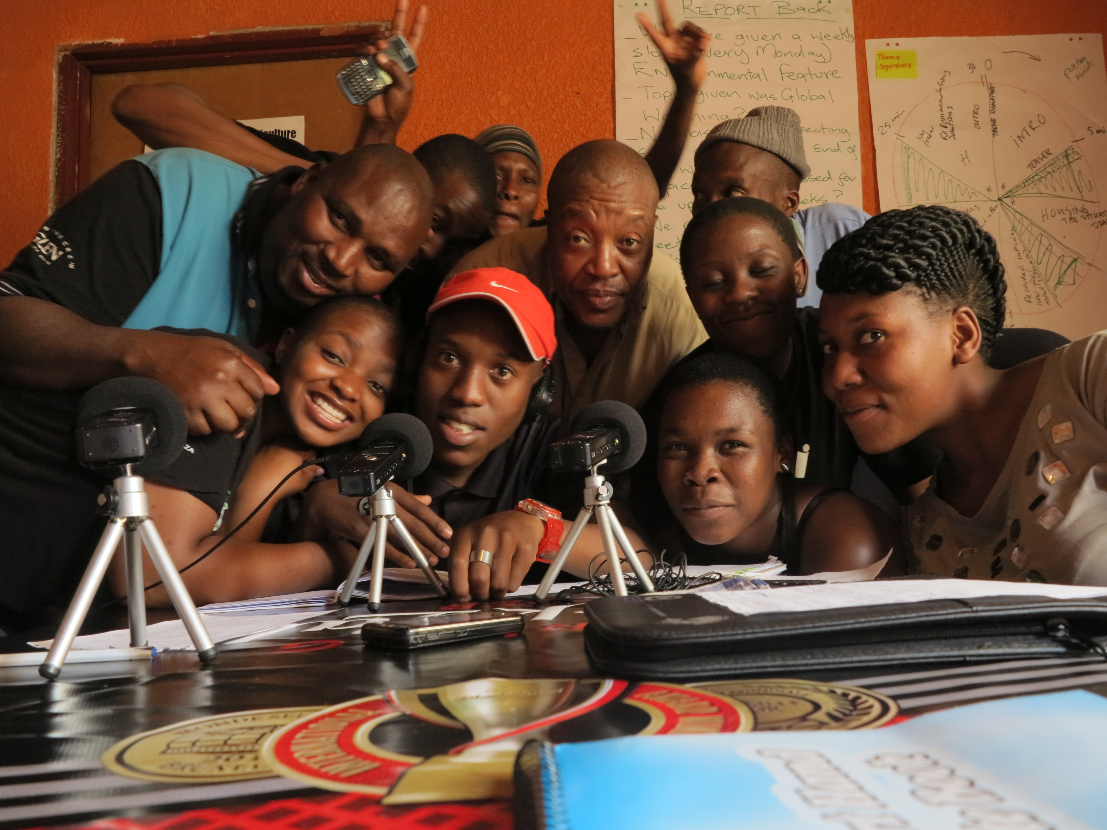
The power of radio
In Africa radio has been credited with the role of developing listening communities that have radically transformed the form of the public sphere from colonial times to the present.
http://www.comminit.com/africa/soul-beat-170.html

Slide 12
While all other kids in the village went to school, Shaheen remained at home & helped her mother with the daily errands. Her family had discontinued her studies.
“I really wanted to study further, but was scared to voice my opinion before my father. I was a regular listener of Galli Galli Sim Sim radio program & had heard people calling & telling their stories. One day I also gathered the courage to call up the channel and narrated all that I wanted to tell my father, why I wanted to study further and my dreams.”
Upon hearing the episode on Radio Mewat, Shaheen’s father realized his mistake, spoke to his daughter & allowed her to continue her education.
https://medium.com/@SesameinIndia/hello-tomorrow-the-power-of-community-radio-for-social-change-c22e35b0f47e

Slide 13
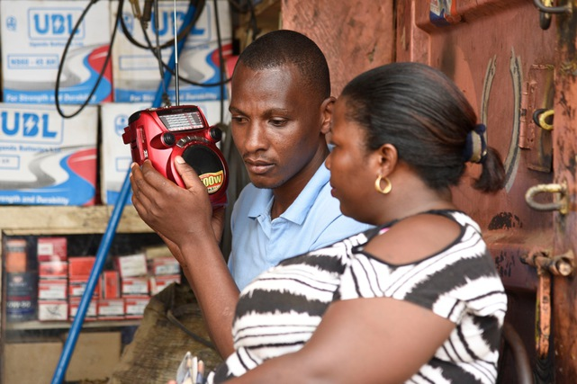
Two models
1. Emphasis on service & community-mindedness:
Focusing on what the station can do for the community.
2. Emphasis on involvement & participation by the listener
Focusing on community members driven and run radio
Notes:
Two philosophical approaches to community radio exist, although the models are not mutually exclusive.

Slide 14
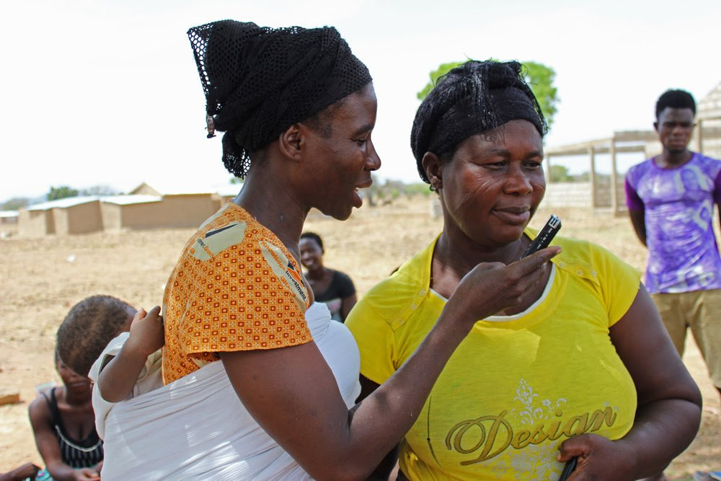
For community based radio to be a tool of communication for development & social change…
…it should be 10 percent radio & 90 percent community.
This means that community radio stations should focus on getting the community talking & not solely on radio (a technological process)
Sébastien Nègre‏ @sebastiennegre

Slide 15
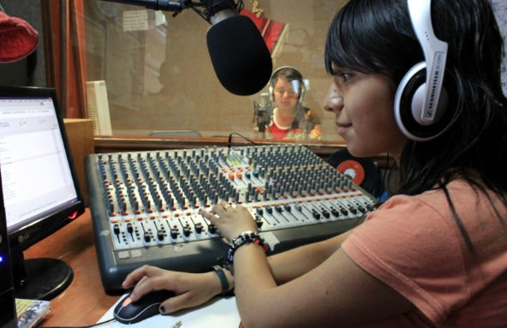
Participation is the KEY WORD:
Participation in ascertaining needs & preferences
Participation in producing programs
Participation in presentation
Participation in evaluation
ALER NOTICIASVerified account
@alerprensa

Slide 16
2 Case studies Insights from Japan’s community radio

Slide 17
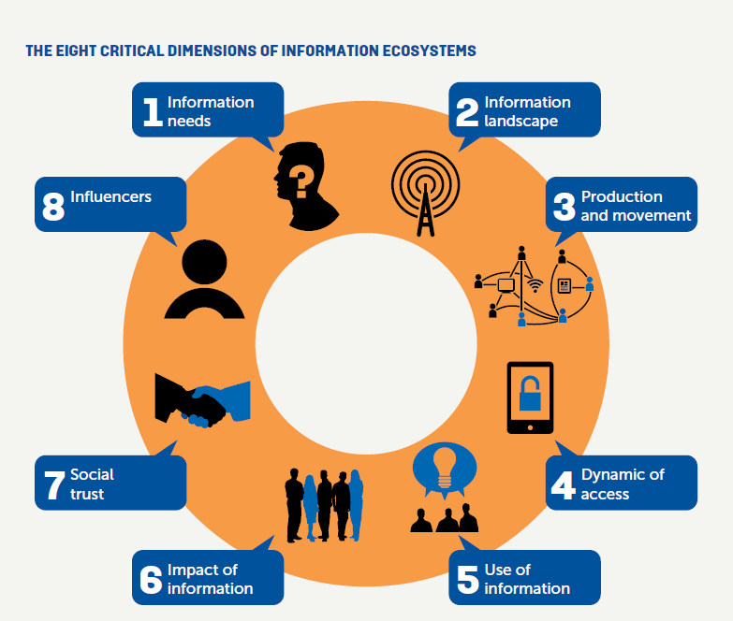
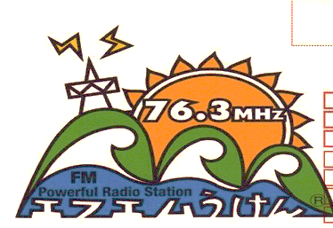
Community based radio in the Information Ecosystems Internews model
Storytelling networks
Communicative rizhomes
Notes:
This is the condensed model developed by internews to map community resilience through mapping information flows.
The use of this information ecosystem mapping helped us better understand how island media is situated in the island’s information landscape,
how it contributes to the production and movement of information flows,
what role it plays in the dynamics of access of information on these islands,
how it meets their information needs,
what impact it has on island identity and everyday life
and who are seen as the influencers in this island media ecosystem.
The expanded version at the end will show how we are contextualizing this model to include some of the following key concepts and terms that we found useful in our exploration of island media: ….

Slide 18
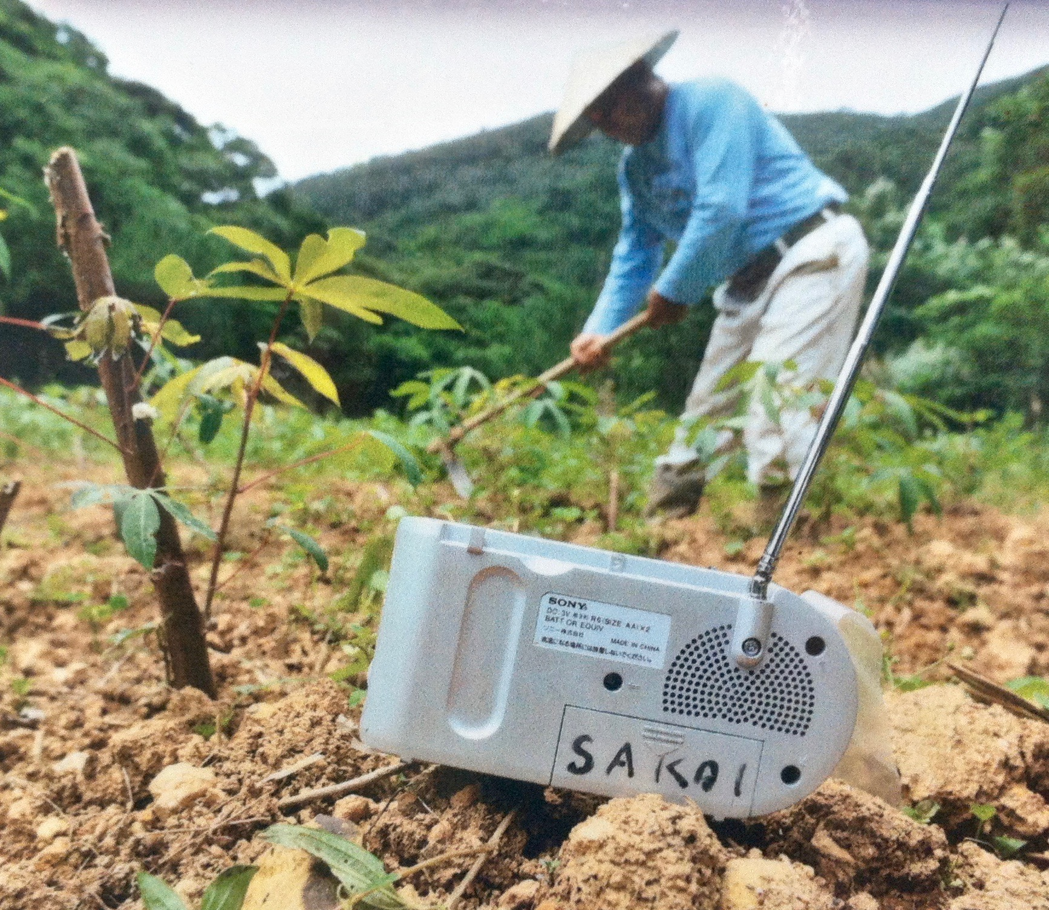
Uken FM “keeping the pigs away from the fields”
The smallest capacity community FM in Japan
“a communication rather than an information tool” (K. Fumoto 2017)
Established in 2010 as a replacement to Mobai Musen system
40 community volunteers
Highly inclusive programming
Notes:
Out of these four FM stations, 2 stand out. One is a community radio in the traditional sense, and the other is what we would describe a urban radio with pan island characteristics
Uken FM known for keeping the pigs away from the fields, they live it playing overnight, has apparently many practical purposes!
Community radio has specific characteristics that set it apart from commercial or national radio broadcasting, and Uken FM demonstrated how a community radio station can be innovative, engaging, resourceful and a key part of sustaining island communities.
Uken FM caters to less than 2000 people in Uken community, with its own dialect and distinctive cultural traditions, and this is what makes it so special – it has become the voice of the village. Many of the programmes have a chatty tone found in face-to-face encounters in the community. For a community that never had a radio experience, they have really embraced it.
Programs examples: old man teaching a younger woman the dialect, shimauta playing, two women chatting about what’s going in town, a book club for children run by a mother with her two kids (spilling off to an off air book reading event), ect

Slide 19
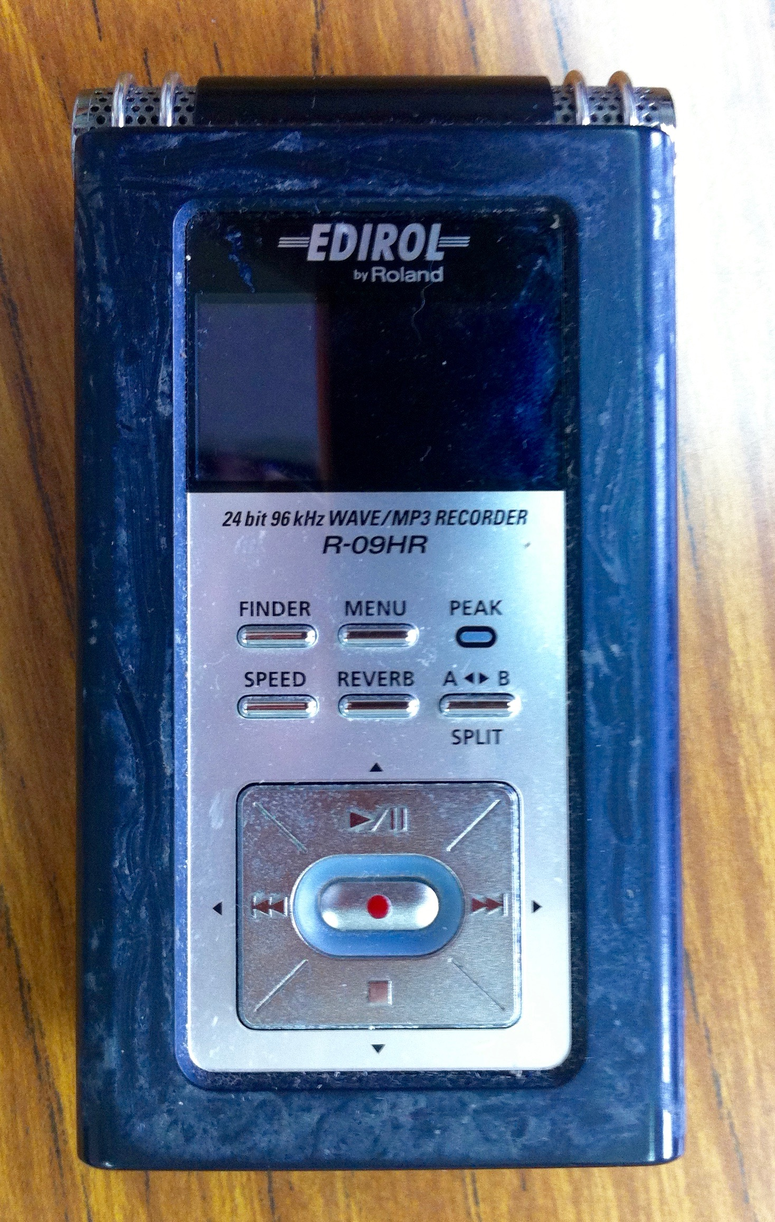
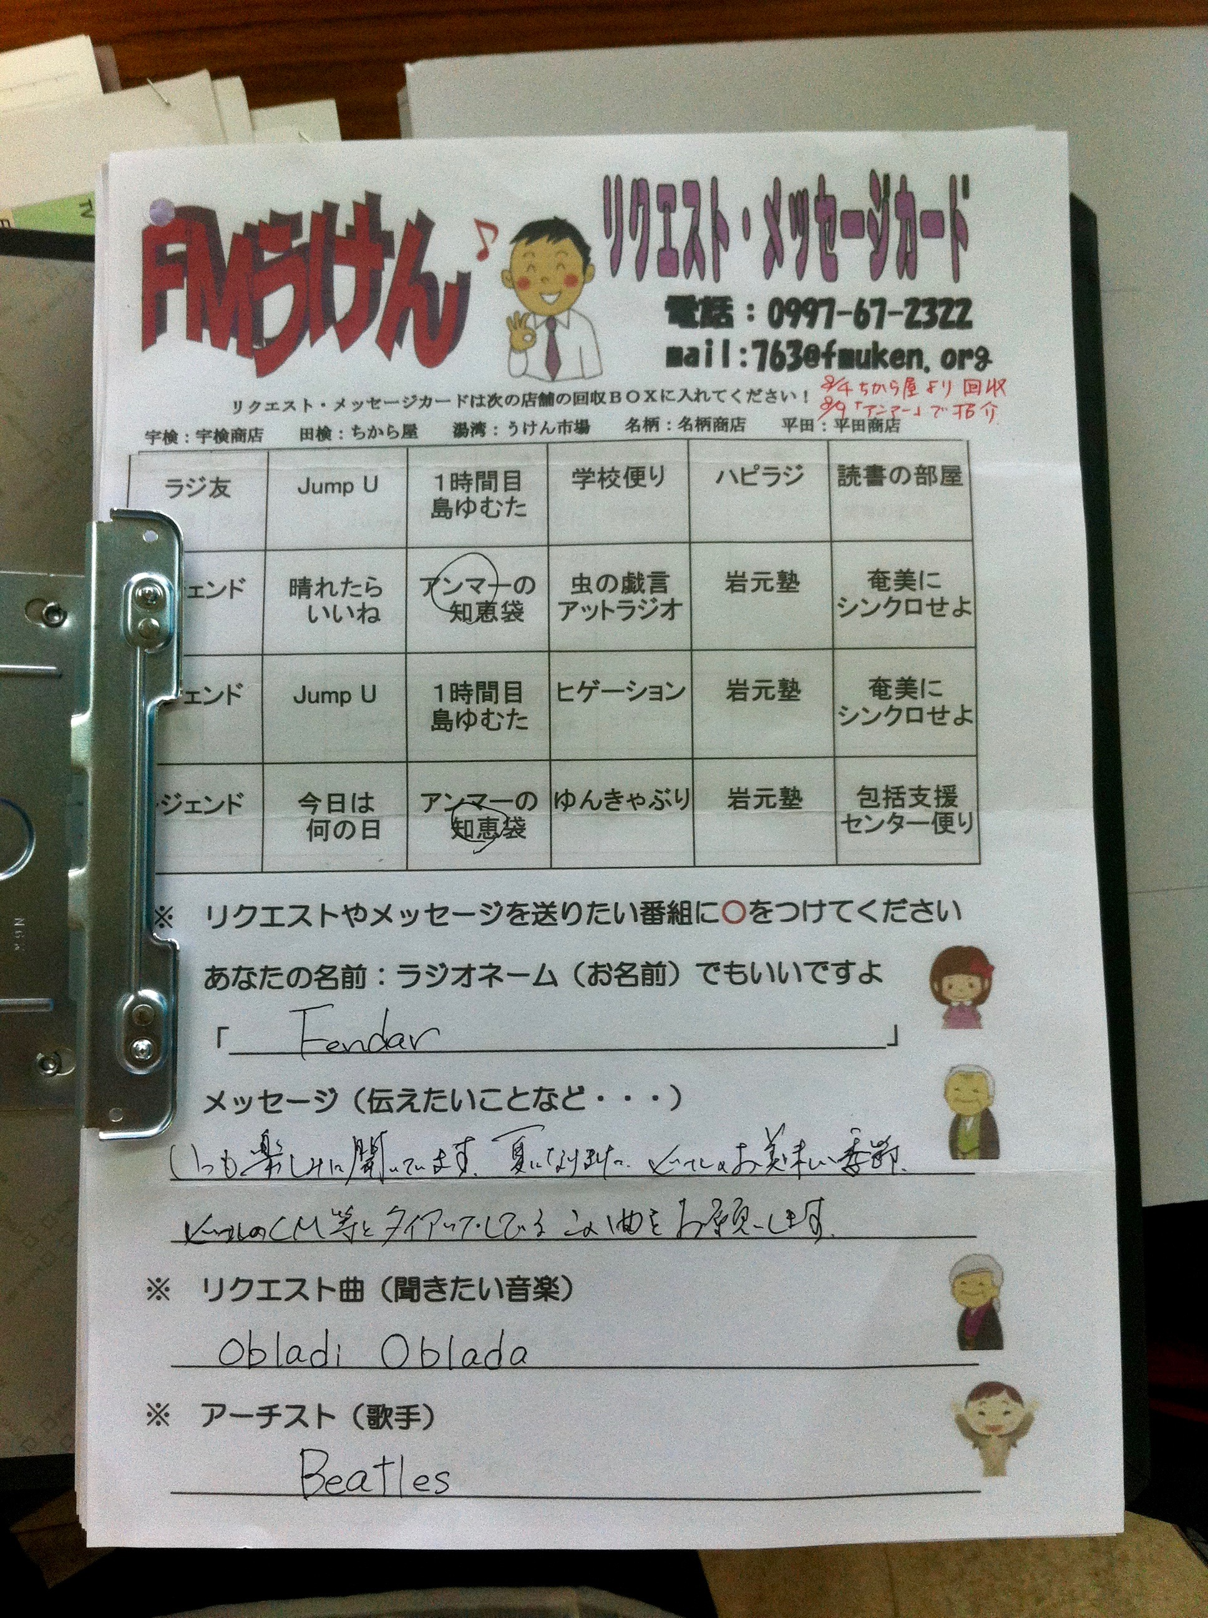
UKEN FM Purpose
…aims to maintain the inherited traditional culture of Uken village and pass down the charm of the village by providing the information of disaster prevention which is important to the life of the people, by sharing the local information and by cooperating and working together with municipality, NPOs, various organizations, residents, schools, shops and so on through undertaking community FM…

Slide 20
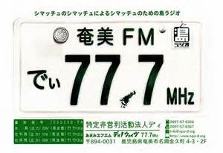
Island identity & urban community FM
Amami FM: “The radio of the islanders, by the islanders and for the islanders”
to enable Amami people to recognize the physical and cultural value of their islands
to treasure and further strengthen the “yui” island value (ties between people)
to pass down to the next generation the uniqueness of the island’s culture
Notes:
A Naze based radio established by Kengo Fumoto, a musician turned major island cultural enabler and storytelling agent. He started the first island FM and set the trend and in a way changing for ever the island’s communicative ecology.
A good example of demonstrating the interconnectedness in island communities.
Sharing not only content with other FMs but also providing support.
While the community FMs serve their own specific shimas/communities they also serve as connecting nodes to other shimas on the island and thus help creating/recreating the island communicative ecology and identity
Focus on the role of cultural enabler who started the trend of community radio in amami
Mention that upon his return he noticed the lack of local island media and media content that is locally produced in the islands. The islanders were used to consume information from the mainland about the mainland and the world and on occasion information about themselves as seen from the mainland often by reporters based on or visiting the islands preparing news for mainland audiences.

Slide 21
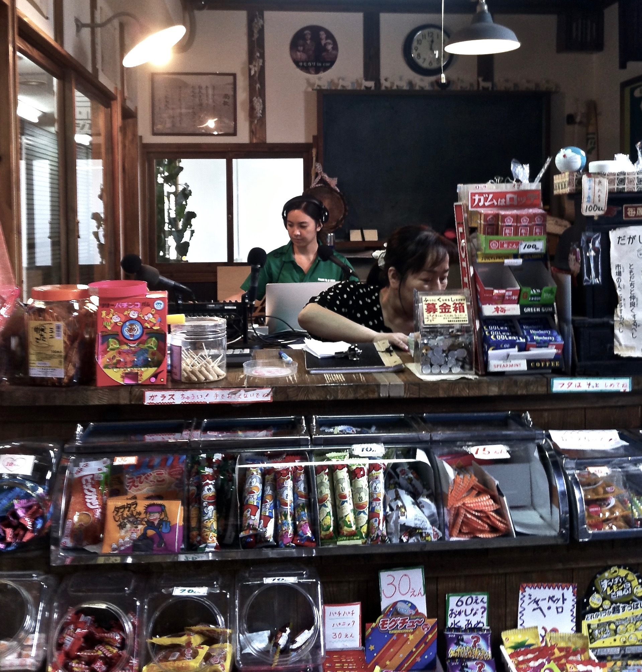
Visible and accessible to community
Notes:
Because these islands were not familiar with having their own radio, he felt the need to make his FM more visible and more approachable.
Physical presence in the center of town, and a second studio in an old market place combined with a convenience store are making a statement in terms of Voice/Access and Participation.

Slide 22
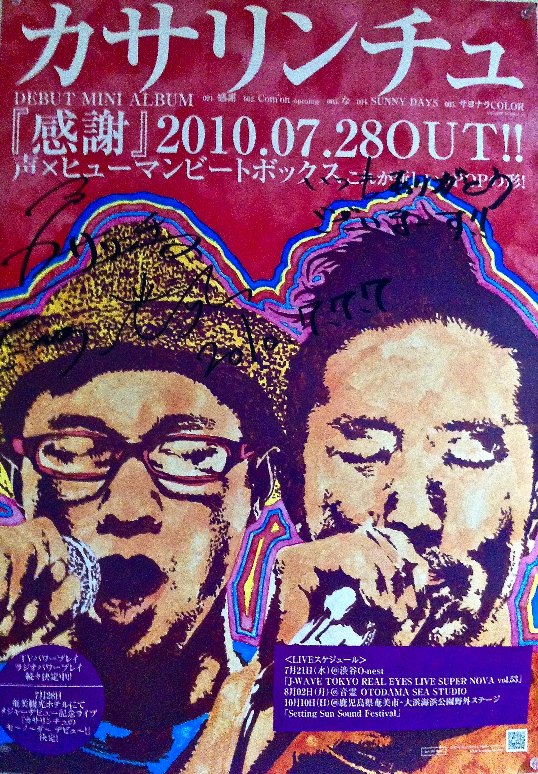
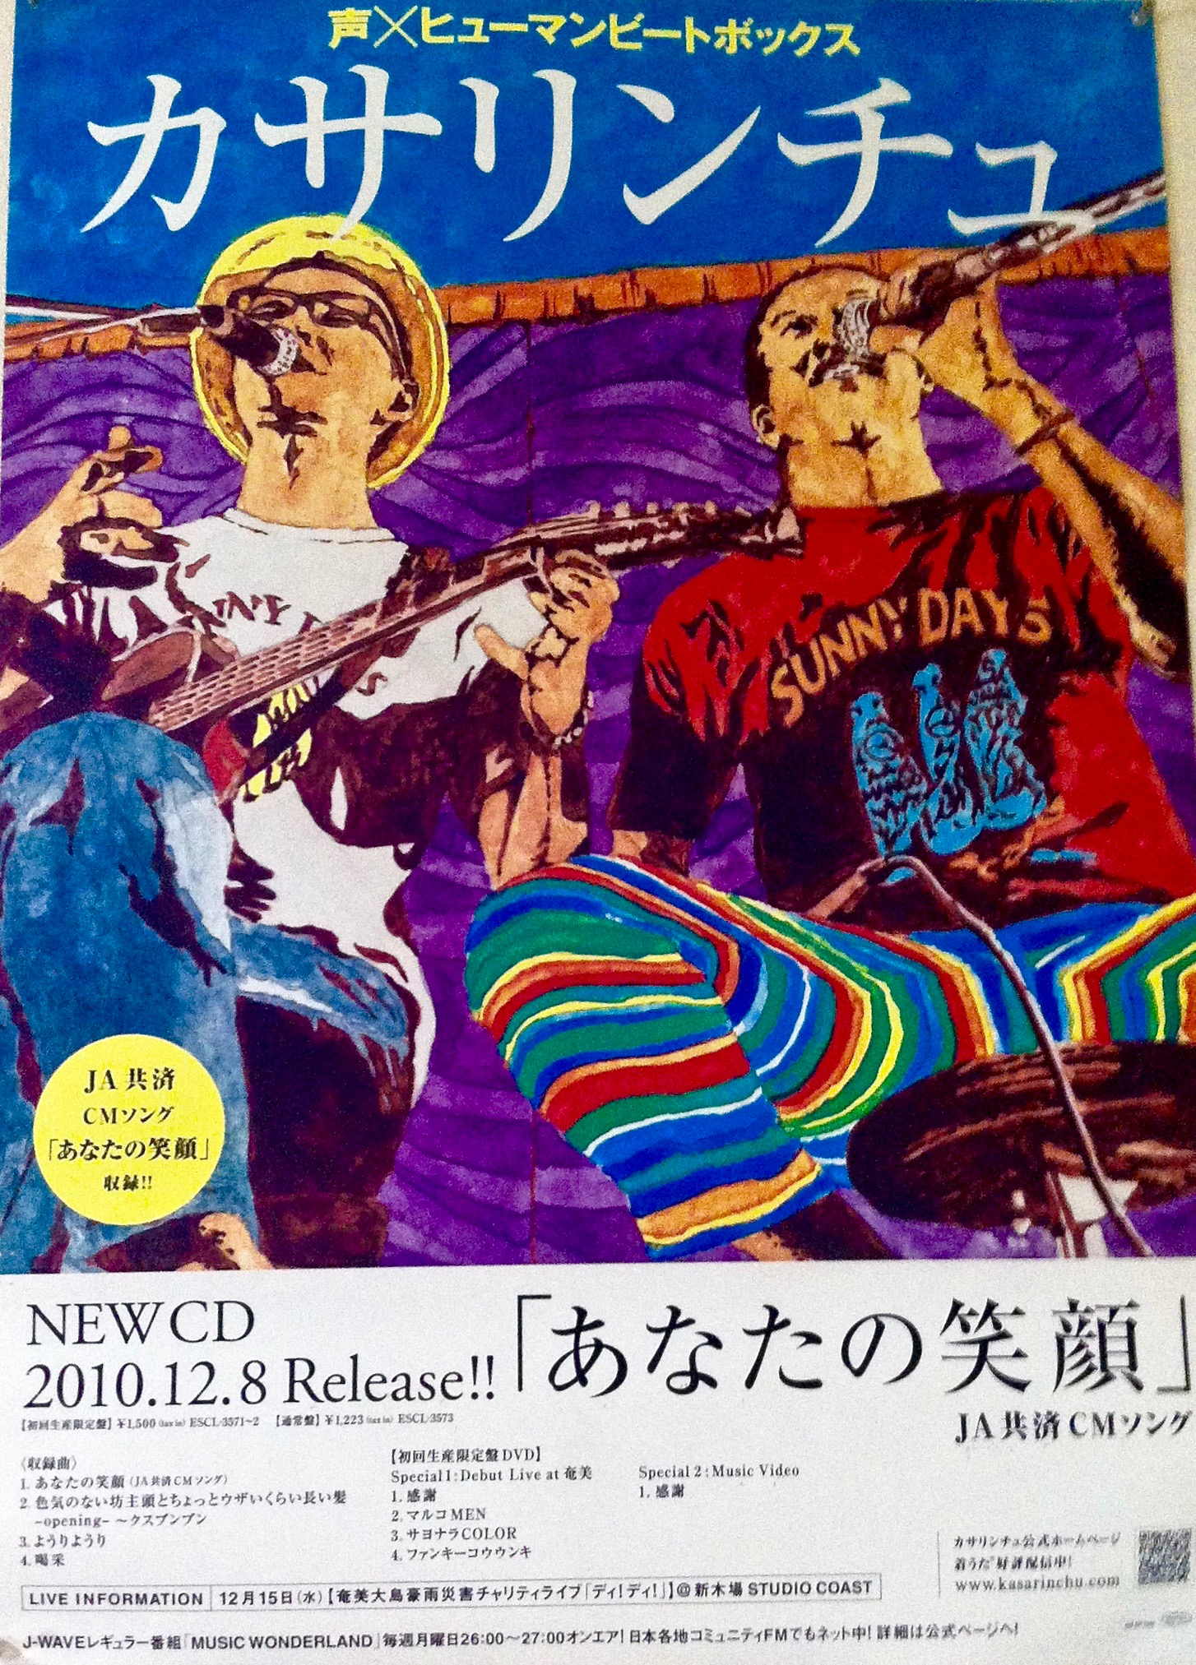
Supporting island musical expression
Notes:
Enabling new island music
This radio has a strong island music content (both traditional and new and hybrid forms)
And he does that in a very unique way by linking Radio programs with a live music space (ASIVI House) situated in the same premises where local and invited artists are invited to give live performances, then going on to give interviews on the radio and having their music promoted.

Slide 23
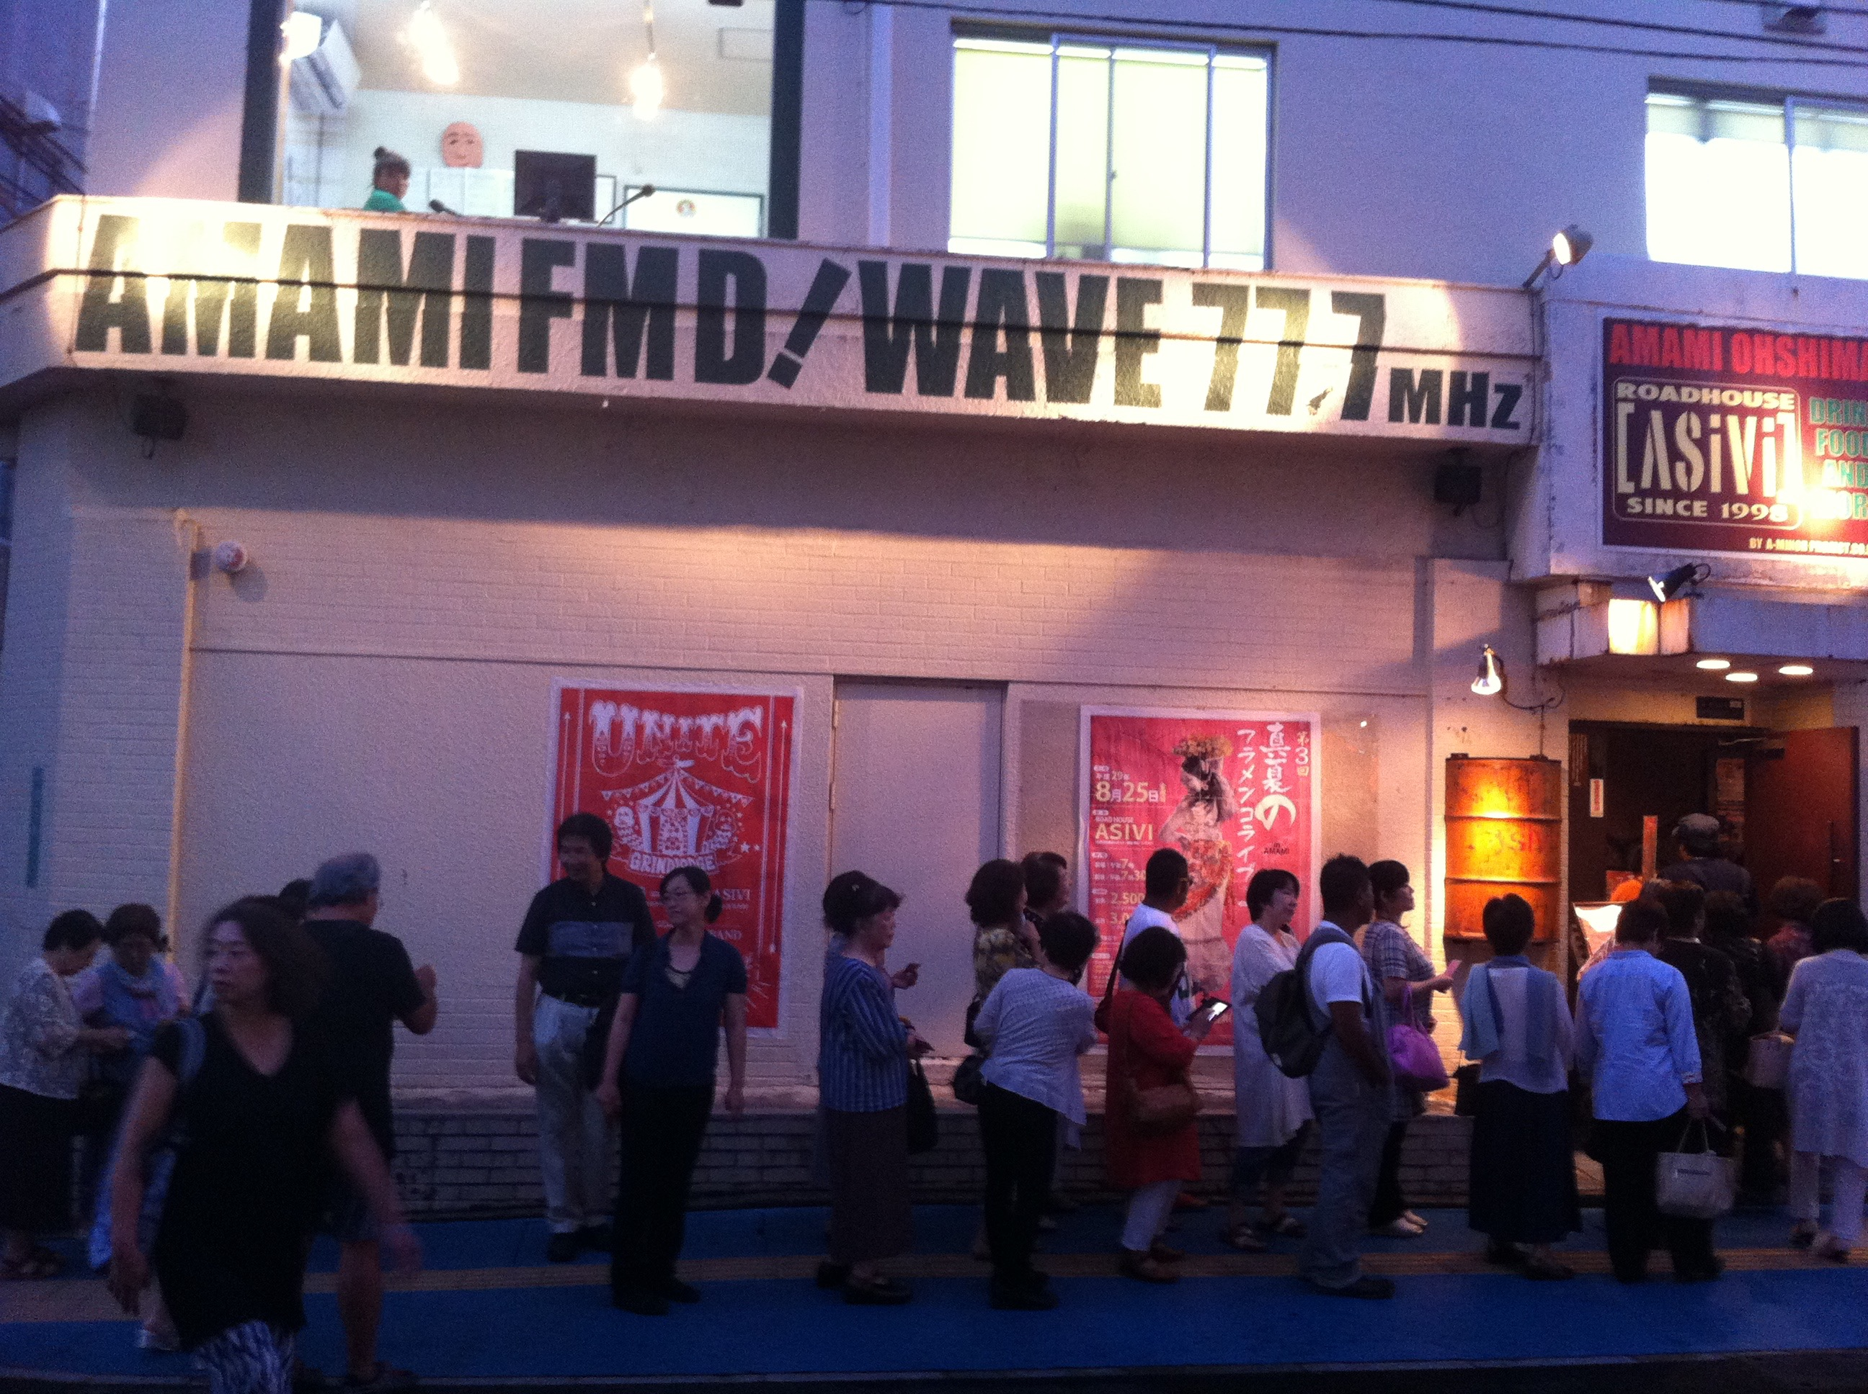
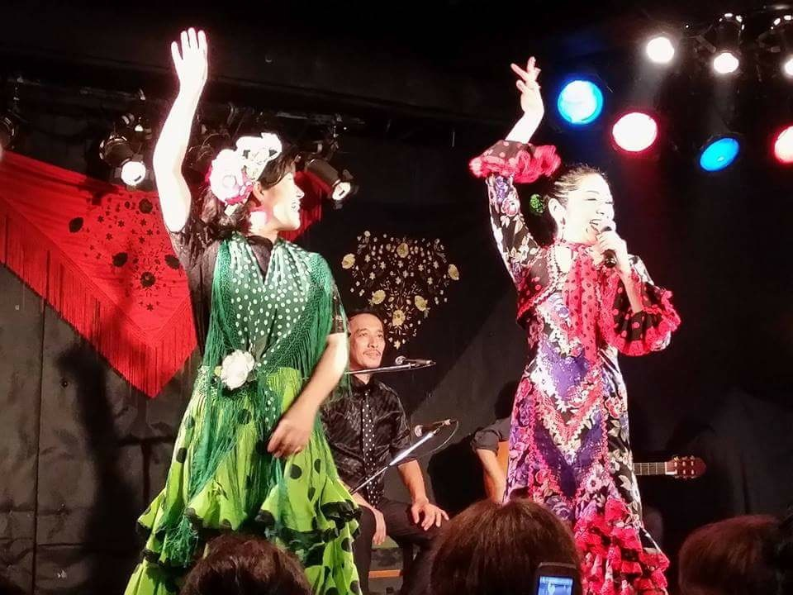
Island communicative rhizomes
Amami FM & Asivi (live music) House
cohabitation of time on air & space (off air ) enables the creation of new island cultural practices that connect the islands with the world & help creating new hybrid, experimental cultural expressions that demonstrate a confident island culture that can absorb outside influences by making them their own in distinctive ways.
Notes:
This is how the radio and the asive house look like....
This concept (island rhizomes) can articulate more explicitly the diversity, complexity, contingency & fluidity of island media & communication networks & agents.
A rhizome is non-linear, anarchic & nomadic & connects any point with any other point, unlike trees or their roots.
Following this analogy, island community media, unlike their mainland/national counterparts, could be seen as part of a more fluid island interconnected network system that embraces both individual & collective agents.

Slide 24
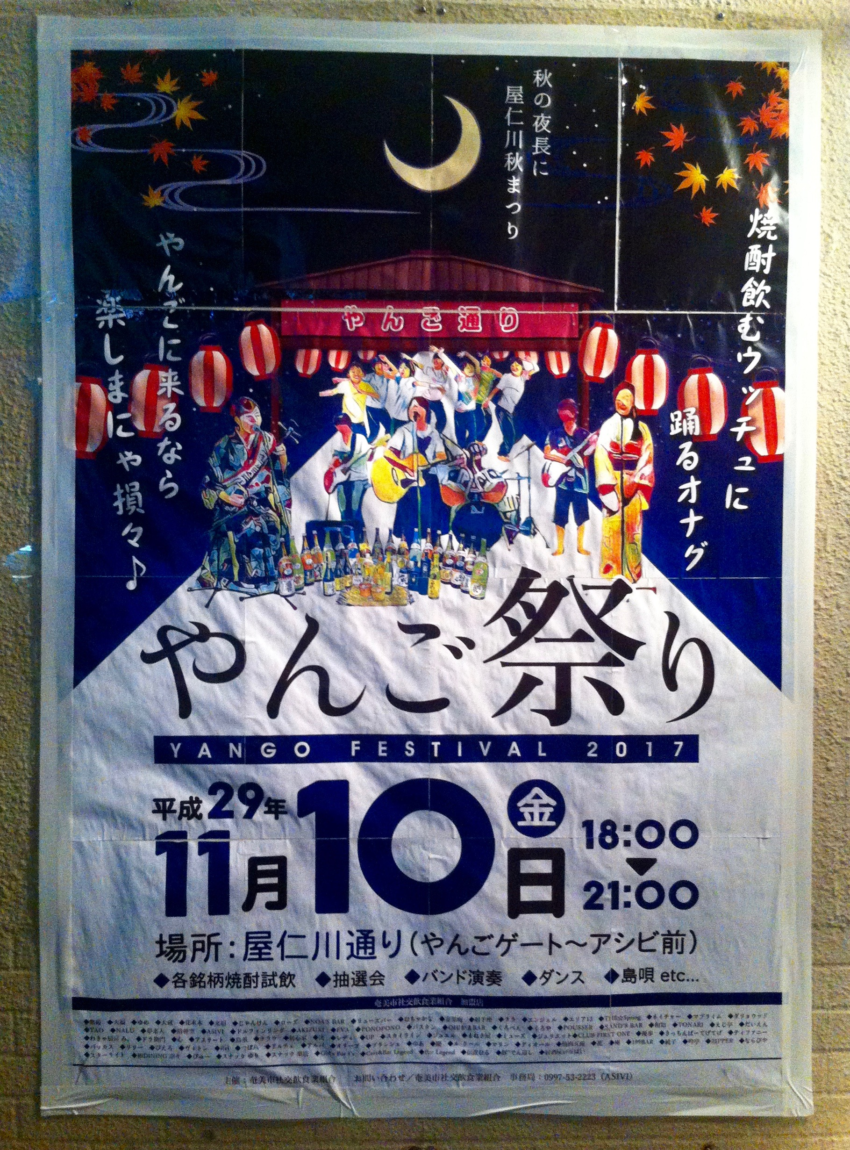
“one of the expressions of the [island] identity can be seen in shimauta or August dance. I think we are not inheriting the figure but the heart. So, the figure should be ok to change over time. For example, I think it is ok today to preform shimauta by playing contemporary band music if it could be understood by the audience….
I am drumming...because I want to send the message that the island is fun and cool”
Kengo Fumoto
Amami FM founder and drums player for the Salmon and Garlic band
Notes:
This shows his desire to have an island culture that continues generating new cultural/musical expressions instead of simply transmitting the traditional ones
This poster is from a night street festival hosted by AMAMI FM which broadcasted live.

Slide 25
Nurturing New & old shima music videos

Slide 26
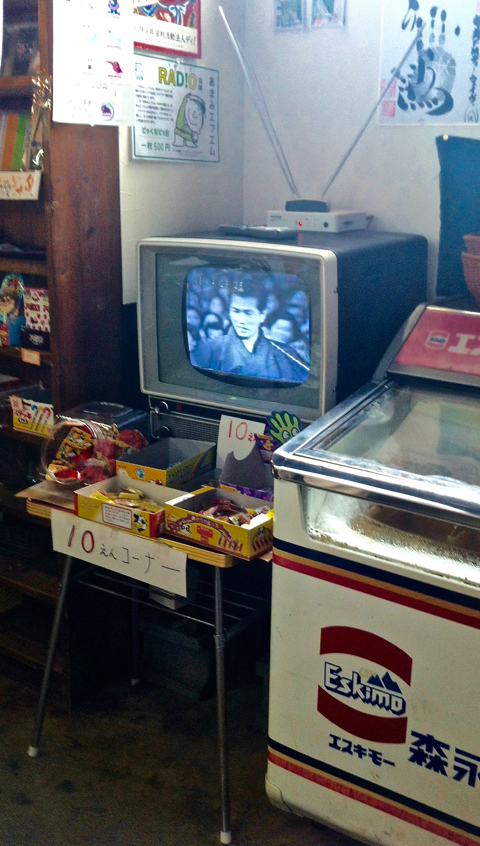
Island radio: integral part of amami islands’ storytelling network
…created through a storytelling process in which Amami island inhabitants, community organizations & local community media work with each other to construct a vision & a reality for their island communities as places where they belong & in which they engage shared concerns (adapted from Kim, Jung, Ball-Rokeach, 2006)
Notes:
3 levels of storytelling agents: micro, meso, macro, differentiated based on their primary storytelling referent & their island audience
Link to next slide on agents of change, that the people who run these radios are not only acting as story telling agents at micro, meso and macro levels (community, pan island and often inter-island) but also a agents of change,,,

Slide 27
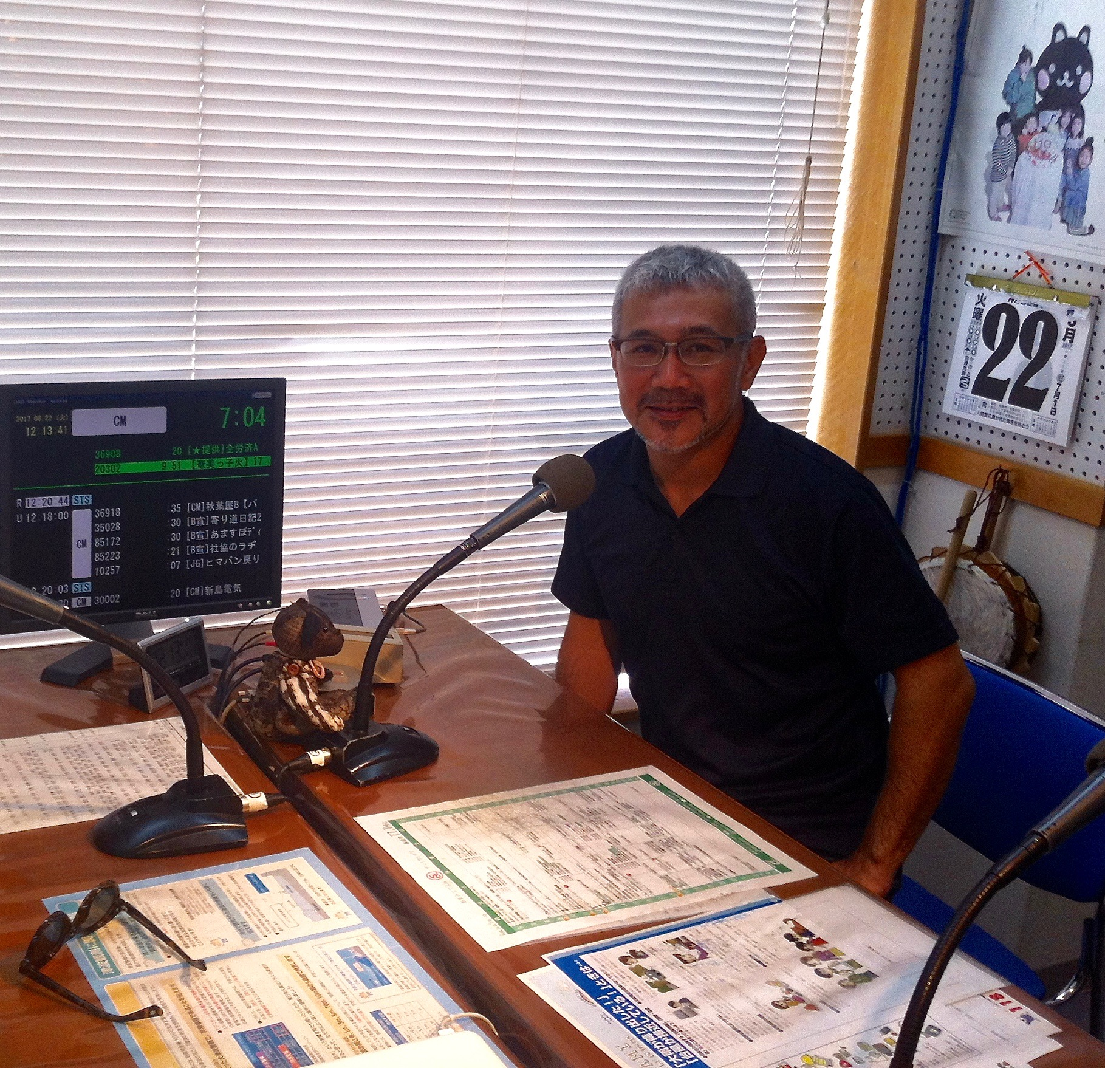
The role of the island catalyst for change & cultural enabler
Kengo Fumoto: the founder of the first island radio (AMAMI FM)
Notes:
Kengo Fumoto is not only a storytelling agent of a storytelling telling network that he set up but also a cultural enabler and a catalyst and he is not the only. During out research we met with a great number of agents of change/cultural enablers that nurture the islands’ communicative ecology
Take of instance Mr Kabayama whose company provides with the technology needed to run this radios and other communication systems. He played an important role in starting Uken FM and he since set up another community radio funded by him.

Slide 28
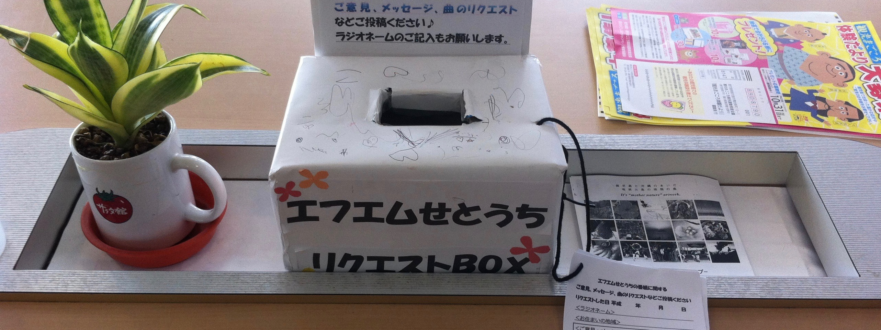
active community media = holistically healthy island communities = sustainable islands
“I cannot imagine Amami Oshima without radio now” (Yuko)
The local media flourishing in Amami Oshima in the last 10 years has contributed to healthier island communities by new layers to the existing island communicative ecology.

Slide 29
Community based radio an an alternative option to market & state
Market
[commercial
exogenous
regional/national]
community
[endogenous voices]
State
[exogenous
mainland/national]
Notes:
how they act as nodal points and construct linkages with market/commercial media and state/national broadcasters/networks

Slide 30
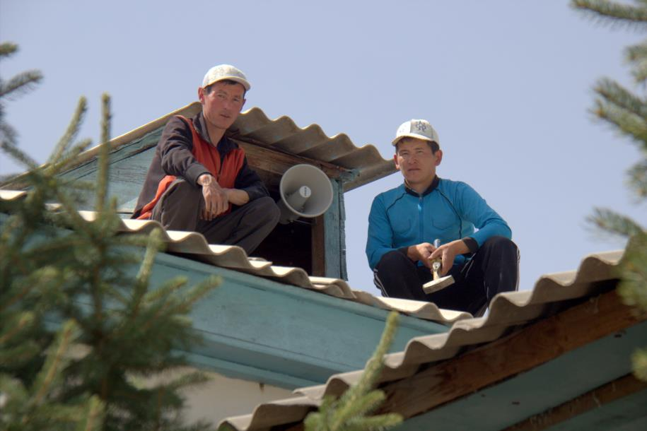
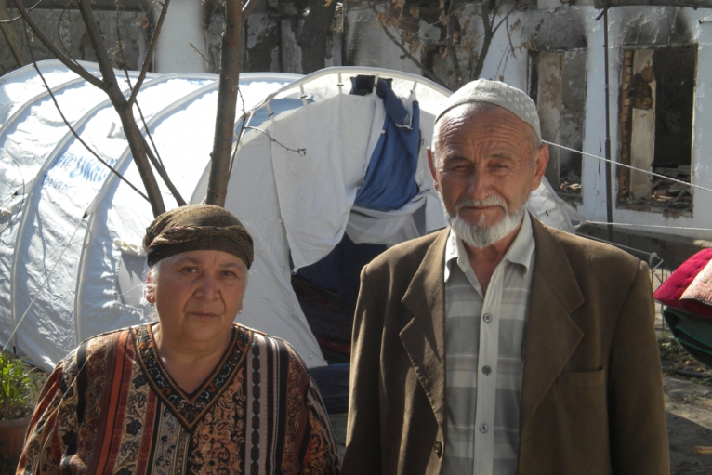
What role can community based radio play in supporting & strengthening Central Asia’s mountainous & remote communities?
Notes:
Perhaps we can start answering or at least discuss this at the end of this presentation

Slide 31
Thank you for listening!
Спасибо!
Рахмет!
evangelia.papoutsaki@ucentralasia.org

Slide 32
CR stations can be empowered with digital media tools. http://comminit.com/ict-4-development/content/community-radio-20
"MOBILE: For phone in programs; use Mobile as FM Radio, Use as Reporting Tool, Use as Camera, Call back on Tollfree numbers, Can be many possibilities if Smartphone is targeted as Mobile users.
SMS [text messaging]: The target community, these days would have more mobile users than even community radio listeners; Reach out to them all through SMS Newsletter by having meticulously aggregated subscription and their numbers with their news and requirements and accordingly send them periodic SMS. It can be called SMS Newsletter.
INTERNET: Web presence with Web 2.0 technology; Integrate all social media like Facebook, Twitter, Slideshare, Flickr, Podcast, and many more.
FACEBOOK: Have individual Facebook Page to engage in sharing news, stories, developments, photos, videos, and generate community including interests in facilitating NGOs and their other works also. The same Facebook page could be embedded in the main website.
YOUTUBE: Have all programs also shoot in videos using camera, mobile, etc. and start individual XYZ Community radio Channel. Video Channel at YouTube would also help having video broadcasting and can be embedded in main website.
TWITTER: For those who would like to play in 140 characters and want to share thoughts and programs among outside world, especially with journalistic bent of mind, can use Twitter]
TEXT: To transcribe all radio programs in textual format also and have them available on the website so that the programs could be consumed in text also without playing video or audio or podcast.

Slide 33
PHOTO-STREAM: Since most of the CRs take lots of pictures, as per programs and content, it is a must-have to share them through photo stream with captions as each photo or a series of photos could be a story telling. Photo stream could be done through Flickr, Picasa, Facebook, Google+, Slide share, Instagram, and so on.
CLOSED CIRCUIT BROADCASTING: If your area has local cable wala, you can use them to broadcast your programs locally also to reach through TVs in household.
PUBLIC SCREENING: Using photos and voice overs and video stories, one can also organise public screening of the programs in the evening and organise discussion over that, which could again another program to broadcast. Public screening can reach to those also who do not listen to CR program and may not have radio sets. This is can be done through LCD/LED projector and a computer or even with Smartphone.
PODCAST AND AUDIO STREAMING: Since all the programs with all CRs are available as digital file, they can be uploaded as podcast files. If necessary, even live streaming could be possible through Internet. The available resources for Podcast, Air Streaming and Live Streaming, please refer software like AirTime (Linux), Amarock (Linux & Windows), VLC, IceCast, Audacity and so on. These softwares help in play-listing, editing, scheduling, playing, and streaming.
CD, DVD, PEN DRIVE: Major programs or those having serious impact could be edited as package and could be made available on CDs, DVDs and Pen Drive for distribution among authorities, occasions, events and for better outreach and public screening.
APPS: Smartphone based App could be a good idea to reach worldwide easily. But it would require expertise in Android development.
BLOGS: The reporters of CR could have their own Blog to share their experience, their thoughts, and their reports. Blogs can be linked to website and social media. Its valuable as individual can write anything they want, which they may be able to do on the CR. The blogs can be done on Facebook, Google Blogerspot, IndiBlog, and so on.
E-RADIO/E-BOOKS: Programs broadcasted on CR could be converted into playlist kind of files and can be made available to be downloaded or on Pen drive. Similarly, even digital books, either as PDF or e-books, could be created by transcribing the CR programs into a textual format.
ONLINE WEBINAR & DISCUSSION FORUMS: To organise online discussion forums and Webinars (Seminars on the Web)"

Slide 34
Benefits of CR:
Democracy in AirOwnership/Control
Social Inclusion
Local Values
Authenticity
Media of the Marginalized
Local Platform
Gender Development
Sustainability:
Social & Financial
Social Sustainability and Social Capital in the community for development
Financial sustainability through low cost solutions, and innovative programming
Community Radio & Rural Development
Facilitates information flow- ensuring improved livelihood of the marginalized
Amplifies the voice of communities
Venue for development dialogues
Enable public adaptation to change and the local appropriation of knowledge and information

